Slide 1
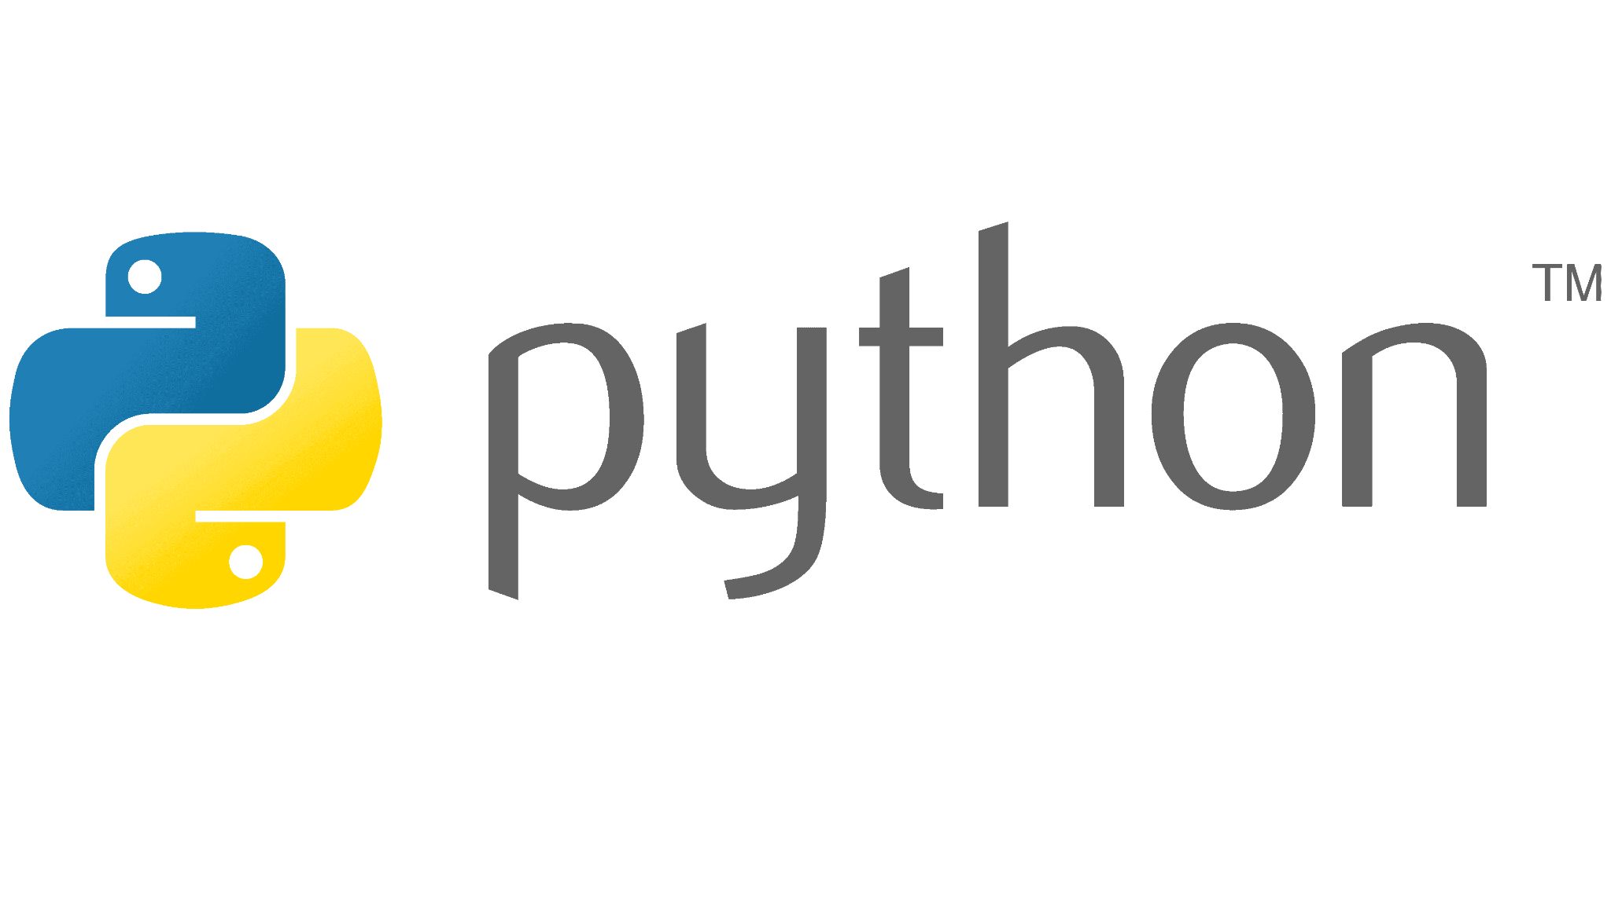


Slide 2

Last lecture reminder
We learned about:
What is the main thread
Local scope vs Global scope
What are conditional statements and why we need them
Python conditional statements syntax
if
else
else if
“switch case” condition approach
Nested conditions

Slide 3
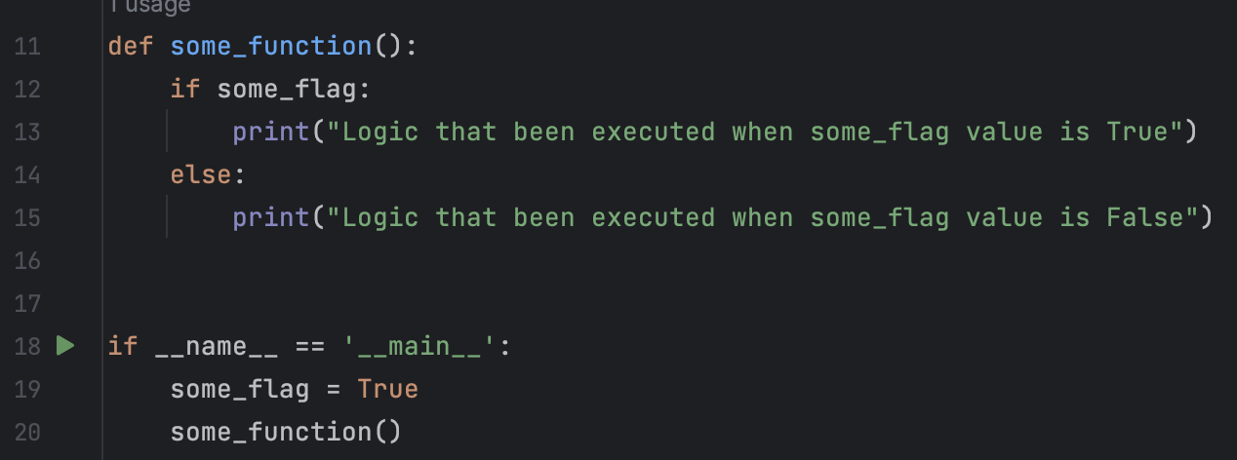
Boolean variables in conditions
Reminder: booleans are data types that can store only true or false values We can use boolean variables in conditional statements instead of providing a specific condition.
Boolean variables that are used inside conditional statements called “flags”

Slide 4
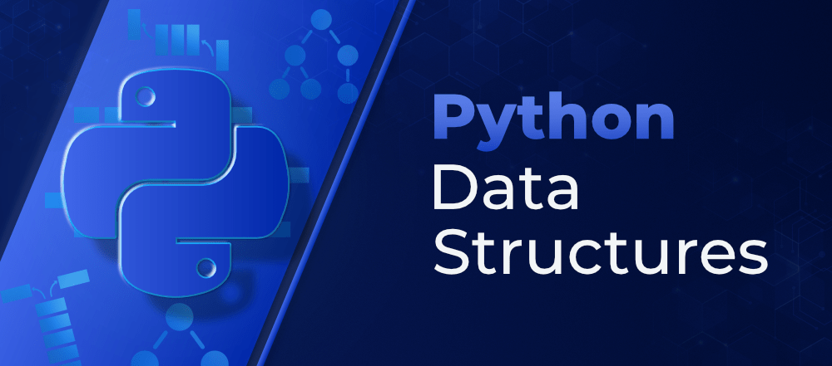

Slide 5
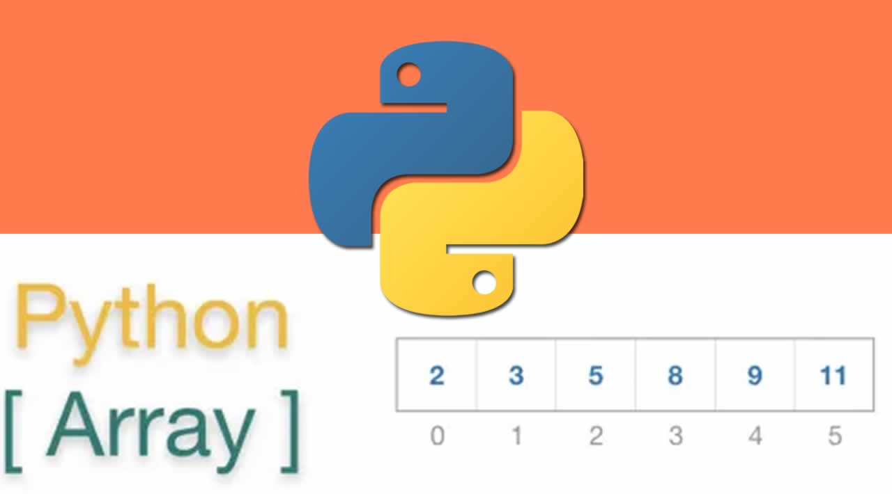

Slide 6
Arrays in Python
Array in Python is a different data type then what we learned until now
Arrays allow us to save in them multiple objects, We call the objects inside the array elements
When we create an array we don’t need to specify its length or the type of elements that it’s going to hold
All the elements inside the array are organized by indexing
The index of an element is the place in the array that this element is located at

Slide 7
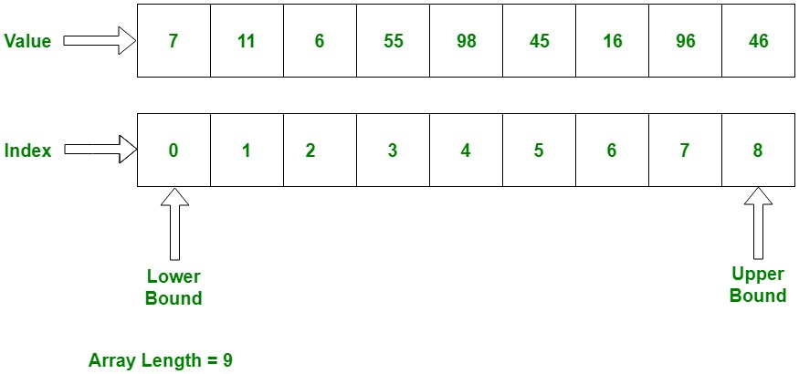
How arrays are built?

Slide 8
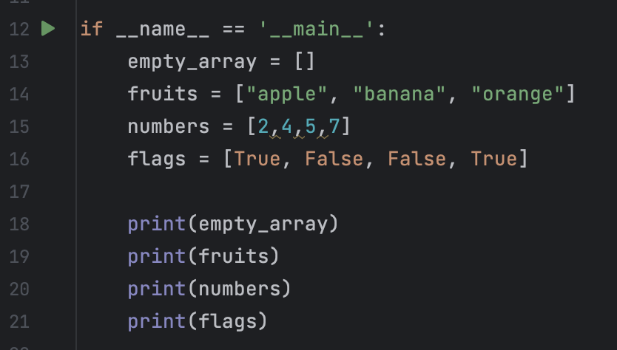
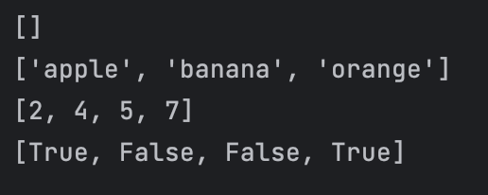
Python array syntax
By using the [] symbol we are declaring on a new array
We can assign the array that we created to a variable just like with other data types

Slide 9
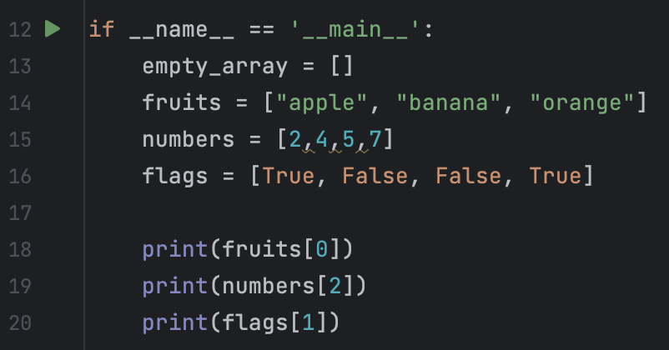
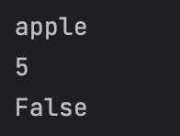
Array get element by index
If we will want to get a specific element only (for example the second element), we will need to provide the index of the element that we want to retrieve
We can do it by put a number between the [] symbol → [1]
get the element of index number 1 (meaning the second element in the array)

Slide 10
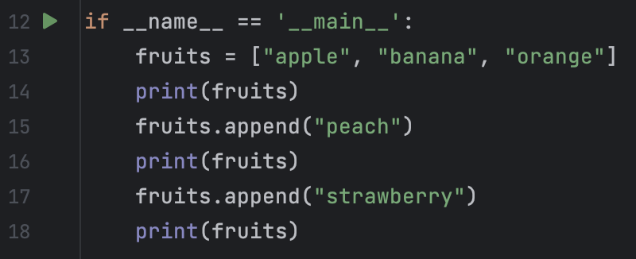
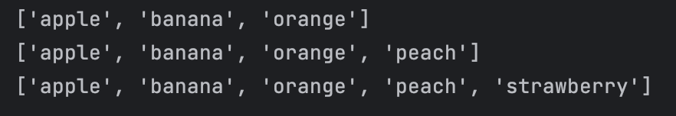
Array add element by index
If we will want to add new value to an already existed array we can do it by using the appeand() method. This method will add the element we pass as a parameter to the end of the existing array
Note: If you will provide an index which is higher than the last index in the array, the interpreter will throw an error.
add new element (“peach”)
to the 4th place in the array

Slide 11
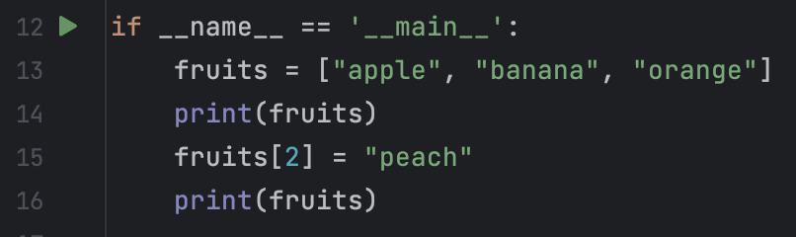
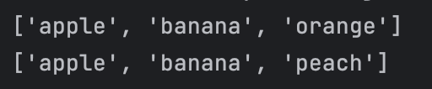
Array replace element by index
If we will want to update our array, meaning replace a value in an existing index, we should provide the index of the element we want to replace and the new value we want to save inside this index.
Replace an element in index 2 from “orange” to “peach”

Slide 12
Array methods and properties
Arrays in Python are not primitive data types, so they have methods and properties that we can use.
Properties - properties are the values that are associated with non primitive data types, we can think on properties as the “data type details”
Methods - methods are actions that we can perform on properties of non primitive data types, methods behave just like regular functions just that they are associated to a specific data type
Example for array property :
length - In most languages the size of the array is part of its properties, in Python however we have len() function which we pass the array as parameter and return it’s size.

Slide 13
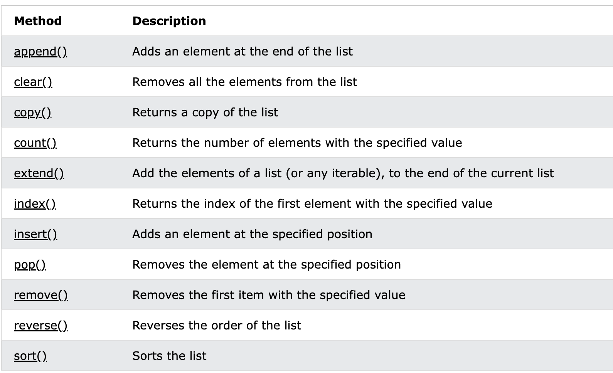
Array methods and properties
Examples for array methods in Python:

Slide 14
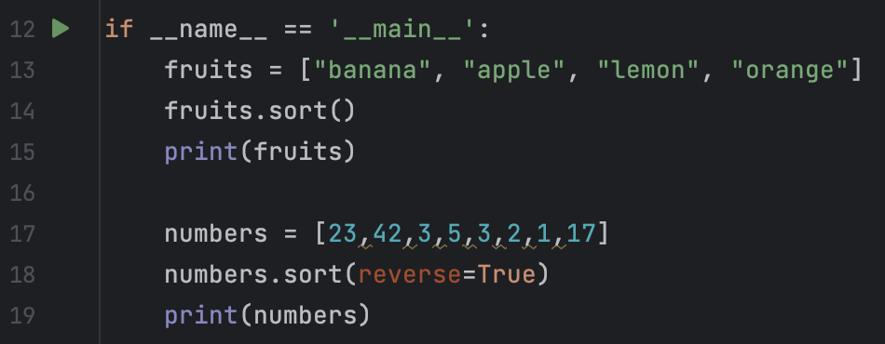
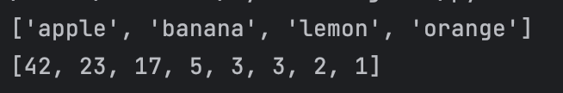
Array methods and properties
Use ASC default sort() method
Use DESC configured sort() method

Slide 15
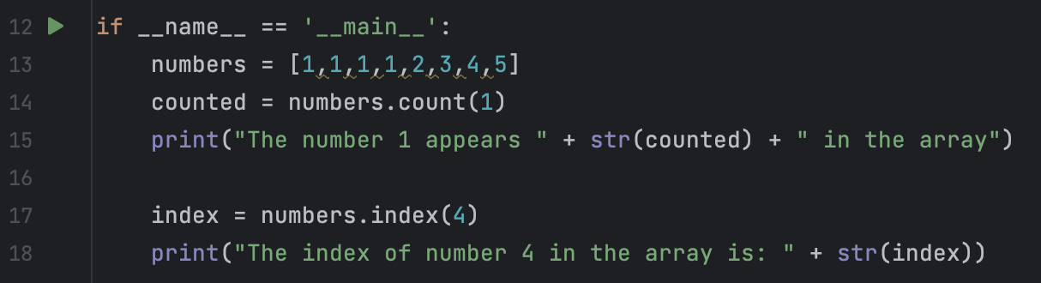

Array methods and properties
use the count() method
use the index() method

Slide 16
Array methods and properties
use the count() method
use the index() method

Slide 17
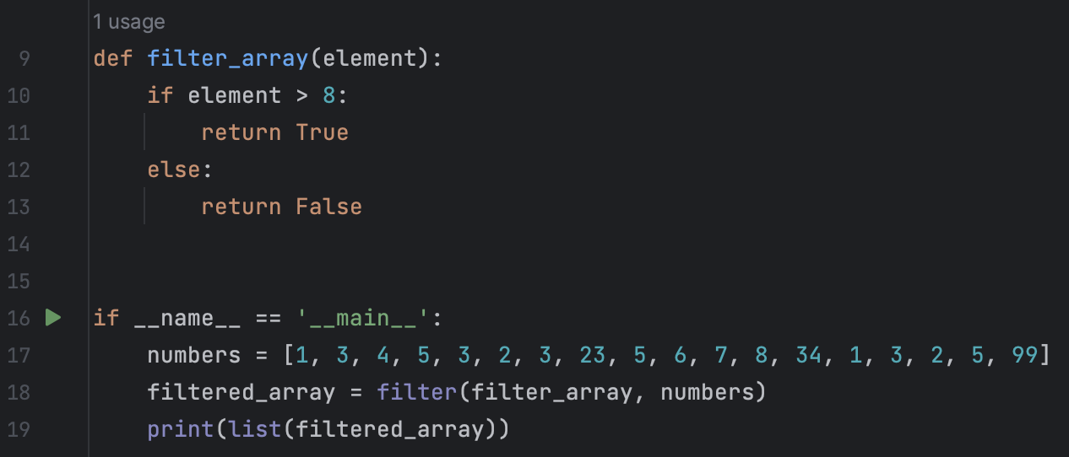

Array methods and properties
We will create a dedicated filter function with the filter logic that we want to apply
We will call the filter() function, passing the filter function and the array we want to filter
We will cast the result back to list using the list() function in order to print it properly

Slide 18
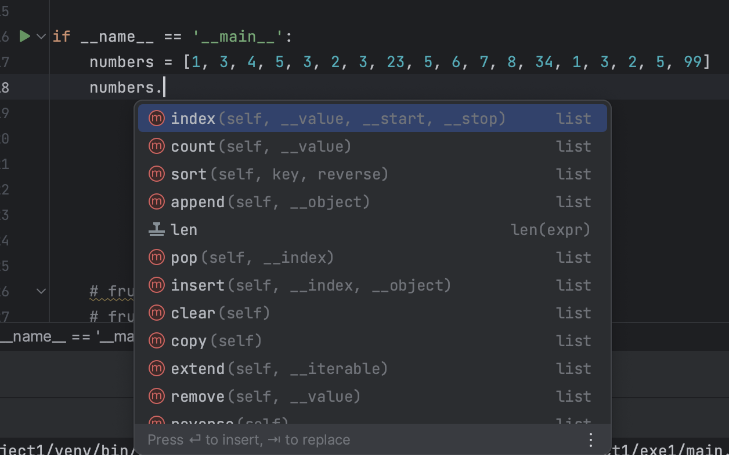
Access to properties and methods
As we saw, the array data type has its own properties (like length) and methods (like sort())
So now we need a way to access to those properties and methods.
For that reason we have the dot symbol - (.)
By using the dot after a data type we can see all the properties and the methods that we have access to
For Example -

Slide 19
Class Exercise - Arrays

Slide 20

Class Exercise - Arrays
Instructions:
Open your Pycharm project and create new Python package called “Python arrays”
Your mission is to implement all the following instructions
Create a new item array contain 5 items at your choice.
Add 2 more items to the end of the array.
Remove the first item from the array and print it.
Sort the array in regular a,b,c order
Sort the array in reverse a,b,c order
Create a new array contain 5 numbers
Print the index of each element in the array
Filter every element that divided by 4 without remain
Go to https://www.w3schools.com/python/python_ref_list.asp
Create a new array of any data type that you like
Choose 1 method from the website that we didn’t used in the class and use it

Slide 21
Class Exercise - Arrays Solution

